Slide 1
TACO BELL | ARN
The Pipeline Bible
Field Development Playbook & Training Manual
How a disciplined, sequenced pipeline protects the schedule — and how to run it.
Built fresh · Made to order · Served on time.
“We focus on making the tacos, not the sausage.”
Multi-State Field Development (CA · WI · CO · NM · TX · IL) · Companion to the ARN Pipeline Bible workbook · As of 6/25/26

Slide 2
PIPELINE PLAYBOOK
TACO BELL | ARN
Why the Bible Matters
The spreadsheet isn't a tracker — it's a playbook. Each field is a gate, and the column order is the critical path that protects your opening date.
Sequence
No missed steps
Accountability
Measurement
Every site moves stage-by-stage. The order things happen in is what optimizes the schedule.
Each required field is a checkpoint. A blank in an early column is a gate not yet cleared.
Owners + due dates + stoplight flags make slippage visible the moment it happens.
Status, timing, and risk roll up to one dashboard — manage by exception, weekly.
Executed well and managed closely, this is the single most effective field-development management tool ARN has.
The Taco Bell way: a great deal, like a great taco, is built in order — skip a layer and it falls apart.
2

Slide 3
PIPELINE PLAYBOOK
TACO BELL | ARN
How the Workbook Works
DASHBOARD
KPIs for status, timing & accountability — the weekly management view.
Stage tabs
One tab per pipeline stage (SIP → … → Opened). A site lives on the tab matching its stage.
Columns = gates
Read left-to-right: each column is the next thing that must happen, in order.
Stoplight (RAG)
STATUS, RISK, Action Flag & SOP auto-color green / amber / red so problems pop.
Renewal Tracker
Separate asset-management track for lease renewals & option-notice critical dates.
Rule of thumb: the template is the bible — every other sheet conforms to it. Added columns are tagged so the canonical structure stays clean.
3

Slide 4
PIPELINE PLAYBOOK
TACO BELL | ARN
The Front Door — Your Landing Page
OPENS FIRST
The workbook lands here every time — one calm screen instead of 30-plus tabs.
6 live KPI cards
Portfolio counts, renewals due, data gaps and this-week actions update themselves on open.
One-tap navigation
Branded buttons jump straight to the Dashboard, Add / Close, Renewals, Cell Sites and Excess Properties.
Built for everyone
Exec, field RE and finance each have a labeled path in — no spreadsheet skills required.
Always current
Every number recomputes on open — the front page is never stale.
Rule of thumb: if you are not sure where to go, go to the Front Door — it routes you to the right tab.
4

Slide 5
PIPELINE PLAYBOOK
TACO BELL | ARN
The Pipeline at a Glance
Eight development stages — plus a parallel renewals track for the existing portfolio.
1 SIP
›
2 LOI
›
3 Legal / Lease
›
4 Due Diligence
Tour, score, qualify
Negotiate terms
Execute lease/PSA
Entitlements, site plan
● < $5K
● $5–15K
● $40–80K
● $75–150K
5 Committee
›
6 Permitting
›
7 Construction
›
8 Open · Live Más
Capital approval
CDs → permit
Possession → build
Open & hand off
● ~$1.5–2.5M*
● $75–150K
● $1.2–2.2M
● Revenue in
● = risk level (green / amber / red) · $ = planning estimate of capital at risk — verify to ARN actuals.
PARALLEL TRACK — RENEWALS: existing restaurants are managed on the Renewal Tracker. The option-notice deadline is the critical date; SOP margin drives the renew / renegotiate / relocate / close decision.
5

Slide 6
PIPELINE PLAYBOOK
TACO BELL | ARN
The Development Lifecycle — Baseline from Real Deal Data
Median elapsed days per phase, computed from the prior rollout's actual milestone dates. Permitting reset to current ARN markets.
Transparency — the machine behind these numbers: 22 completed openings + 101 committee-approved projects. Per-phase sample (n) shown in the legend.
BASELINE — LOI → OPEN
≈ 683 days (~22 months)
PRE-APPROVAL — ~159 days
LOI → committee. Lower commitment; you can still walk.
POST-APPROVAL — ~524 days
Capital committed: permitting & construction. The clock runs hard.
THE LONG POLE Approval → Permit ≈ ~1 year (ground-up) in current ARN markets — conversions potentially ~6 months. Far above construction (~130d). Front-load entitlements.
*Permitting = current ARN markets ~1 yr ground-up / ~6 mo conversion; historical baseline was ~205d. Other phases = prior-rollout medians (n in legend). Track ARN variance in the bible.
6

Slide 7
PIPELINE PLAYBOOK
TACO BELL | ARN
Stage 1 — SIP (Sites in Process)
▼ YOU ARE HERE
SIP
›
LOI
›
Legal/ Lease
›
Due Dil. & Entitle
›
Committee Approval
›
Permitting
›
Construction
›
Open
Purpose
Source, tour, score and qualify candidate sites against the trade-area strategy.
KEY BIBLE FIELDS
Date Toured
Trade Area
Size
For Sale / Lease
Price
Aerial / Site Plan / Flyer
STATUS
Gate to advance
Site qualified and engaged (offer / LOI intent) → STATUS = In Negotiation
DON'T-MISS STEPS
▪ Run the site scorecard & trade-area fit
▪ Confirm drive-thru feasibility & stacking
▪ Secure all asset docs (aerial, plat, flyer)
OWNER
Real Estate
TYPICAL DURATION
Ongoing
CAPITAL & RISK
$$$$
LOW
EST. $ AT RISK
< $5K
Pitfall Chasing sites that don't fit the trade-area strategy — discipline here saves money downstream.
Sourcing & tour time — little cash committed.
7

Slide 8
PIPELINE PLAYBOOK
TACO BELL | ARN
Stage 2 — LOI (Letter of Intent)
▼ YOU ARE HERE
SIP
›
LOI
›
Legal/ Lease
›
Due Dil. & Entitle
›
Committee Approval
›
Permitting
›
Construction
›
Open
Purpose
Negotiate and execute non-binding deal terms before spending on diligence.
KEY BIBLE FIELDS
Offer
Price / Rate
LOI Sent
LOI Executed
DON'T-MISS STEPS
Gate to advance
Executed LOI / LL work exhibit
▪ Lock rent, TI, term & options, exclusivity
▪ Build in a diligence period & outs
▪ Define delivery condition
OWNER
Real Estate
TYPICAL DURATION
~68 d → DD (baseline)
CAPITAL & RISK
$$$$
LOW
EST. $ AT RISK
$5–15K
Pitfall A vague LOI gets renegotiated later. No DD-out = capital at risk before you can walk.
Non-binding terms — minimal cash; sets the deal.
8

Slide 9
PIPELINE PLAYBOOK
TACO BELL | ARN
Stage 3 — Legal / Lease (or PSA)
▼ YOU ARE HERE
SIP
›
LOI
›
Legal/ Lease
›
Due Dil. & Entitle
›
Committee Approval
›
Permitting
›
Construction
›
Open
Purpose
Draft, negotiate and fully execute the lease or purchase agreement.
KEY BIBLE FIELDS
LS (Lease Status)
Lease / Committee Comments
Title / PTR
Phase I
ALTA Survey
Gate to advance
Lease / PSA fully executed (LS = Lease Status)
DON'T-MISS STEPS
▪ Pull title/PTR & estoppels
▪ Order Phase I environmental
▪ Order ALTA survey
OWNER
Legal + Real Estate
TYPICAL DURATION
4–10 weeks
CAPITAL & RISK
$$$$
HIGH
EST. $ AT RISK
$40–80K
Pitfall Starting capital-heavy diligence before terms are locked burns money on dead deals.
Lease / PSA execution = first major commitment; + title / Phase I / survey.
9

Slide 10
PIPELINE PLAYBOOK
TACO BELL | ARN
Stage 4 — Due Diligence & Entitlements
▼ YOU ARE HERE
SIP
›
LOI
›
Legal/ Lease
›
Due Dil. & Entitle
›
Committee Approval
›
Permitting
›
Construction
›
Open
Purpose
Prove the site is buildable — zoning, site plan, re-plat, utilities, signage.
KEY BIBLE FIELDS
Re-Plat Start / Complete
Site / Floor Plan
Signage Research
Utilities
Gate to advance
Entitlements / site plan approved; DD cleared
DON'T-MISS STEPS
▪ Secure zoning / CUP & re-plat
▪ Confirm civil, utilities & access
▪ Lock signage & drive-thru approvals
OWNER
Real Estate
TYPICAL DURATION
~91 d intake→approval (baseline)
CAPITAL & RISK
$$$$
MED–HIGH
EST. $ AT RISK
$75–150K
Pitfall Entitlement delay is the #1 schedule killer — start early and run it in parallel with legal.
At-risk capital — survey, civil & entitlement consultants.
10

Slide 11
PIPELINE PLAYBOOK
TACO BELL | ARN
Stage 5 — Committee Approval (RE Committee)
▼ YOU ARE HERE
SIP
›
LOI
›
Legal/ Lease
›
Due Dil. & Entitle
›
Committee Approval
›
Permitting
›
Construction
›
Open
Purpose
Secure capital approval at the Real Estate Committee.
KEY BIBLE FIELDS
RE Committee Date
RISK
A&C Package
Proforma
DON'T-MISS STEPS
Gate to advance
RE Committee Date — approved
▪ Complete A&C package & proforma
▪ Assign a risk rating
▪ Attach site scorecard & comps
OWNER
Exec + Real Estate
TYPICAL DURATION
1–2 weeks (cycle-bound)
CAPITAL & RISK
$$$$
APPROVE
EST. $ AT RISK
~$1.5–2.5M*
Pitfall An incomplete package = deferral = a missed committee cycle and weeks of lost time.
Capital is formally authorized here — go / no-go gate.
11

Slide 12
PIPELINE PLAYBOOK
TACO BELL | ARN
Stage 6 — Permitting
▼ YOU ARE HERE
SIP
›
LOI
›
Legal/ Lease
›
Due Dil. & Entitle
›
Committee Approval
›
Permitting
›
Construction
›
Open
Purpose
Complete construction documents and obtain the building permit.
KEY BIBLE FIELDS
Permit Ready
Last Permit Date
CDs Complete
DON'T-MISS STEPS
Gate to advance
Permit Ready / permit issued
▪ Finish CDs & submit early
▪ Track jurisdiction review cycles
▪ Clear off-site / utility permits
OWNER
Construction
TYPICAL DURATION
~1 yr ground-up · ~6 mo conversion
CAPITAL & RISK
$$$$
MED
EST. $ AT RISK
$75–150K
Pitfall Underestimating municipal review time. Build the real review cycle into the schedule.
CD / architect fees + permit costs.
12

Slide 13
PIPELINE PLAYBOOK
TACO BELL | ARN
Stage 7 — Construction
▼ YOU ARE HERE
SIP
›
LOI
›
Legal/ Lease
›
Due Dil. & Entitle
›
Committee Approval
›
Permitting
›
Construction
›
Open
Purpose
Take possession and build the restaurant.
KEY BIBLE FIELDS
Poss Date
Start Const
Const Duration
Sched Opening
DON'T-MISS STEPS
Gate to advance
Possession → Start Construction → Construction complete / CO
▪ Order long-lead equipment (FF&E) at permit
▪ Run hiring & training in parallel
▪ Schedule CO / final inspection
OWNER
Construction
TYPICAL DURATION
~130 d (baseline)
CAPITAL & RISK
$$$$
PEAK
EST. $ AT RISK
$1.2–2.2M
Pitfall Not ordering long-lead items early, and hiring serially instead of in parallel with the build.
Peak cash outlay — construction budget + FF&E.
13

Slide 14
PIPELINE PLAYBOOK
TACO BELL | ARN
Stage 8 — Open · Live Más
▼ YOU ARE HERE
SIP
›
LOI
›
Legal/ Lease
›
Due Dil. & Entitle
›
Committee Approval
›
Permitting
›
Construction
›
Open
Purpose
Open the restaurant and hand off to Operations — opening day is the Live Más payoff.
KEY BIBLE FIELDS
Sched Opening
Period Opening
Grand-Opening Promo
DON'T-MISS STEPS
Gate to advance
Opening date achieved
▪ Execute grand-opening marketing
▪ Run a 90-day post-open review
▪ Load lease abstract into the Renewal Tracker
OWNER
Ops
TYPICAL DURATION
Open day → 90 days
CAPITAL & RISK
$$$$
REVENUE
EST. $ AT RISK
Revenue in
Pitfall No post-open review, and renewal/option dates never get loaded — re-creating the original miss.
Spend complete — sales begin. Live Más.
14

Slide 15
PIPELINE PLAYBOOK
TACO BELL | ARN
Completing the Lifecycle — Add, Close & Learnings
▼ YOU ARE HERE
OPEN
›
OPERATE
›
RENEW
›
CLOSE
↻
LEARN
A restaurant's life doesn't end at Open — the Bible tracks it cradle-to-grave, and the grave feeds the next site:
▪ Add a Restaurant — a site graduates off SIP into the Master through a validated intake form (Restaurant # · address · city · state required).
▪ Operate & Renew — performance, renewals and remodels keep it a green contributor (covered earlier).
▪ Close a Restaurant — a guided form captures Close Date · Reason · Sales / SOP at close · lease disposition · required Learnings.
▪ Archive — the full record moves to RESTAURANT CLOSURES with Years Open; QA blocks any restaurant from living in both Open and Closures.
▪ Learnings loop — closure reasons recalibrate SIP scoring, so the next hunt avoids the same mistake.
The payoff: every opening and every closing makes the next siting decision smarter — nothing is lost.
15

Slide 16
PIPELINE PLAYBOOK
TACO BELL | ARN
Renewals — Protecting the Existing Portfolio
Renewals run in parallel to the development pipeline. The option-notice deadline is a hard, unforgiving date — miss it and you can forfeit the option or fall into holdover.
THE CRITICAL DATE
THE DECISION — SOP TRIAGE
▪ Track LL Notice Date for every lease
▪ Notice Status auto-flags On Track / Due <180d / <90d / Overdue
▪ Work backward from the deadline — start early
▪ Load every new restaurant's dates the day it opens
▪ Green ≥25% renew on strong terms
▪ Amber 15–25% renegotiate / improve economics
▪ Red <15% fix rent or relocate / close
5 renewals in flight today:
▪ #1968 Albuquerque — SOP 26.6% (green), In Review; proposed 10-yr + 4×5 under review
▪ #28512 Bellflower — SOP 2.8% (red), At Risk; must cut rent or close, remodel tied to deal
▪ #2828 Long Beach — SOP 24.1% (amber); hard expiry 12/31/30, align 3-brand renewals
▪ #28521 Lomita — SOP 17.2% (amber), contact made; #3186 Centennial — 24.0% (amber), not yet started
16

Slide 17
PIPELINE PLAYBOOK
TACO BELL | ARN
Critical Path & Schedule Optimization
The column order is the critical path. Two habits protect the opening date:
RUN TRACKS IN PARALLEL
TREAT EVERY FIELD AS A GATE
▪ Legal/lease + entitlements at the same time
▪ Order long-lead FF&E the moment permit is in sight
▪ Hire & train while construction runs
▪ Renewals worked years ahead of expiry
▪ A blank required cell = a step not done
▪ Dates create the schedule; variance shows slippage
▪ Days-to columns count down automatically
▪ Manage by exception: red & overdue first
Schedule math, automated in the bible:
▪ Days Since Toured / Days to Open / Sched Var update daily via TODAY()
▪ Action Flag turns red the day a Next Step Due passes
▪ Notice Status flags renewals before the window closes
17

Slide 18
PIPELINE PLAYBOOK
TACO BELL | ARN
Roles, Accountability & Weekly Cadence
WHO OWNS WHAT
Real Estate
Construction
Legal
Sourcing, LOI, entitlements, renewals
Permitting, build, FF&E, CO
Lease/PSA, title, estoppels
Ops
Exec
Opening, staffing, post-open
Committee approval, capital, strategy
THE WEEKLY PIPELINE REVIEW
▪ Open the DASHBOARD — read Overdue Actions, status mix, days-to-open, renewal flags
▪ Sort SIP by Action Flag: clear every Overdue and Due-Soon item first
▪ Review every Blocked / At-Risk site — decide: push, pause, or kill
▪ Check renewals: any Notice Status amber/red gets a dated next step
▪ Update Lead + Next Step + Due on every active row before you close the meeting
18

Slide 19
TACO BELL | ARN
The Workbook — A Tab-by-Tab Roadmap
What each tab tracks, where it sits in development, and why it's critical.

Slide 20
PIPELINE PLAYBOOK
TACO BELL | ARN
Workbook Scorecard — All Tabs at a Glance
Tabs run in development order; the Master (Open Restaurants) is the destination. Each tab is a gate — the column order is the critical path.
Tab
Role in the lifecycle
Owner
# Fields
Why it's critical
DASHBOARD
Command center / KPI rollup
Exec / All
KPIs
Run the weekly review on one screen
SIP
Stage 1 — site inception
Real Estate
41
Every deal is born here
Pre-DD Pipeline
Sourcing → LOI (pre-diligence)
Real Estate
33
Locks the deal before the capital ask
Due Diligence
DD intake → diligence / entitlements
RE / Legal
34
Proves buildability; #1 schedule risk
Committee Approved
Capital approved at RE Committee
Exec / Finance
37
The go / no-go capital gate
2026 Openings YTD
Construction → open
Construction / Ops
38
Asset goes live (Live Más)
REMODEL PIPELINE
Remodels in process
Construction
15
Keeps image current; flags slips
RENEWAL TRACKER
Lease renewals (asset mgmt)
RE / Legal
18
Option-notice = unforgiving gate
OPEN RESTAURANTS — MASTER
Operating truth + financials
Finance/Legal + All
21
THE master every tab feeds
20

Slide 21
PIPELINE PLAYBOOK
TACO BELL | ARN
QA SELF-TEST
SIP
›
Pre-DD
›
Due Dil.
›
Committee
›
Openings
›
Master
↳ WORKBOOK INTEGRITY — runs across every tab (a hidden self-test, not a stage in the line)
ROLE IN THE LIFECYCLE
Self-testing — live tripwires run every time the file opens.
TRACKS THESE FIELDS (10 total)
▪ Required fields present — Restaurant # · address · city · state on every record
▪ No restaurant in both OPEN and CLOSURES (lifecycle integrity)
▪ Ownership populated ≥ 197 · every leased restaurant carries rent
▪ Renewal & cell-site countdown dates resolve — no #REF!
▪ Result: 10 / 10 PASS — green means ship it
Why it's critical
Catches broken links, missing required fields and lifecycle conflicts before they reach Rob or Mazen.
OWNER
Advisor / Ellis Advisors
TASKS / FIELDS TRACKED: 10
21

Slide 22
PIPELINE PLAYBOOK
TACO BELL | ARN
Approval Gates: Pre-DD → Due Diligence → RE Committee
DD Intake = the capital request that opens due diligence. RE Committee = the Real Estate approval committee. “Pre-” = work done before that gate.
◀ THE ROADMAP — development flows left → right; each gate must clear before the next
Pre-DD
›
DD INTAKE
›
DUE DILIGENCE
›
RE COMMITTEE
›
Permitting
›
Construction
›
Open
Source · tour · LOI
Diligence opens; capital request
Diligence · entitlements
Committee approval
CDs → permit
Possession → build
Live Más
SIP / Pre-DD Pipeline
Pre-DD Pipeline
Due Diligence
Committee Approved
(stage)
2026 Openings
Master
Why the gates matter:
• A deal cannot pass a gate until its fields are complete — that's how the bible prevents missed steps.
• Capital is only at risk after DD intake; it's only committed after RE Committee approval.
• Due Diligence (diligence/entitlements) is where schedules slip — start it in parallel with legal.
• Each tab in the workbook corresponds to one of these gates; a site advances tab-to-tab.
22

Slide 23
PIPELINE PLAYBOOK
TACO BELL | ARN
SIP — Sites in Process
▼ YOU ARE HERE
SIP
›
Pre-DD
›
Due Dil.
›
Committee
›
Openings
›
Master
ROLE IN THE LIFECYCLE
Stage 1 — site inception. Every candidate site enters here from touring; the data lifecycle starts at this tab.
TRACKS THESE FIELDS (41 total)
▪ Date Toured · Market / State · Trade Area · Intersection / Center
▪ Size · For Sale / For Lease · Price · Offer
▪ Aerial · Site Plan · Flyer (links)
▪ STATUS · Stage · RISK (stoplight)
▪ Lead · Next Step · Next Step Due · Action Flag
▪ Days Since Toured · Days to Open · Sched Var (auto)
Why it's critical
Discipline here protects the whole funnel — only strategy-aligned sites should advance.
OWNER
Real Estate
TASKS / FIELDS TRACKED: 41
23

Slide 24
PIPELINE PLAYBOOK
TACO BELL | ARN
Pre-DD Pipeline
▼ YOU ARE HERE
SIP
›
Pre-DD
›
Due Dil.
›
Committee
›
Openings
›
Master
ROLE IN THE LIFECYCLE
Stages 2–3 — sourcing through LOI, before due diligence opens (the capital request).
TRACKS THESE FIELDS (33 total)
▪ Proj # · Project Name · City / ST
▪ Roles (Real Estate / Construction / Legal / Ops / Exec)
▪ Risk · Drive-Thru
▪ LOI Sent · LOI Executed
▪ RE Committee target date · Lease Status
Why it's critical
Captures the deal and its terms before any capital is requested; LOI dates time the front of the funnel.
OWNER
Real Estate
TASKS / FIELDS TRACKED: 33
24

Slide 25
PIPELINE PLAYBOOK
TACO BELL | ARN
Due Diligence
▼ YOU ARE HERE
SIP
›
Pre-DD
›
Due Dil.
›
Committee
›
Openings
›
Master
ROLE IN THE LIFECYCLE
Stage 4 — diligence & entitlements, after DD intake and before RE Committee approval.
TRACKS THESE FIELDS (34 total)
▪ DD intake date · Committee target date
▪ Re-Plat start / complete
▪ Site / Floor Plan · Signage research
▪ ALTA Survey · Phase I environmental
▪ A&C package · intake → approval duration
Why it's critical
Proves the site is buildable. This is the #1 place schedules slip — run it in parallel with legal.
OWNER
Real Estate / Legal
TASKS / FIELDS TRACKED: 34
25

Slide 26
PIPELINE PLAYBOOK
TACO BELL | ARN
Committee Approved
▼ YOU ARE HERE
SIP
›
Pre-DD
›
Due Dil.
›
Committee
›
Openings
›
Master
ROLE IN THE LIFECYCLE
Stage 5 — capital approved at the RE Committee.
TRACKS THESE FIELDS (37 total)
▪ RE Committee (approval) date
▪ Risk · Lease Status
▪ Permit Ready · Possession date
▪ Start Construction · Sched Opening
▪ Period Opening
Why it's critical
The go / no-go capital gate — nothing builds without it.
OWNER
Exec / Finance
TASKS / FIELDS TRACKED: 37
26

Slide 27
PIPELINE PLAYBOOK
TACO BELL | ARN
2026 Openings YTD
▼ YOU ARE HERE
SIP
›
Pre-DD
›
Due Dil.
›
Committee
›
Openings
›
Master
ROLE IN THE LIFECYCLE
Stages 7–8 — construction to open (Live Más); the YTD opened/opening list.
TRACKS THESE FIELDS (38 total)
▪ Possession · Start Const · Sched / Actual Opening
▪ Rent Commencement
▪ FF&E Order · Staffing / Training Start
▪ Certificate of Occupancy (CO)
▪ 90-Day Post-Open Review · Free Food Day (optional)
Why it's critical
Where the asset goes live; the 90-day post-open review feeds truth back to the Master.
OWNER
Construction / Ops
TASKS / FIELDS TRACKED: 38
27

Slide 28
PIPELINE PLAYBOOK
TACO BELL | ARN
REMODEL PIPELINE
SIP
›
Pre-DD
›
Due Dil.
›
Committee
›
Openings
›
Master
↳ PARALLEL TRACK — Asset Management (runs alongside the pipeline — not a stage in the line)
ROLE IN THE LIFECYCLE
Asset management — remodels in process (from the 5/27/26 list).
TRACKS THESE FIELDS (15 total)
▪ Image / Prototype · Action (Mid-term / Successor)
▪ Date Due · Date Status (EXPIRED / Due Soon / On Track)
▪ FDD Received · RE Committee Order
▪ Material Delivery · Construction Schedule
▪ Flags (past due / missing FDD / not scheduled)
Why it's critical
Keeps the image current; Flags surface discrepancies and EXPIRED dates automatically.
OWNER
Construction
TASKS / FIELDS TRACKED: 15
28

Slide 29
PIPELINE PLAYBOOK
TACO BELL | ARN
RENEWAL TRACKER
SIP
›
Pre-DD
›
Due Dil.
›
Committee
›
Openings
›
Master
↳ PARALLEL TRACK — Asset Management (runs alongside the pipeline — not a stage in the line)
ROLE IN THE LIFECYCLE
Asset management — lease renewals (measured separately from the development pipeline).
TRACKS THESE FIELDS (18 total)
▪ Sales · SOP · Occ % (performance)
▪ Term End · LL Notice Date · Options · Auto-Renew
▪ Days to Notice · Notice Status (auto RAG)
▪ Priority Tier (1 / 2 / 3) · Renewal Status · Owner
▪ Dated & attributed notes — M/D/YY (initials)
Why it's critical
Protects the existing portfolio; the option-notice date is an unforgiving, hard gate.
OWNER
Real Estate / Legal
TASKS / FIELDS TRACKED: 18
29

Slide 30
PIPELINE PLAYBOOK
TACO BELL | ARN
CELL SITES
SIP
›
Pre-DD
›
Due Dil.
›
Committee
›
Openings
›
Master
↳ PARALLEL TRACK — Asset Management · ARN is the LANDLORD (ancillary income — rent flows IN to ARN)
ROLE IN THE LIFECYCLE
Ancillary income — carrier ground / rooftop leases where ARN collects rent.
TRACKS THESE FIELDS (2 active)
▪ AT&T D-003 (5654 Greenwood Plaza, CO) — 25% / term escalator since 2000 has pushed rent ABOVE market
▪ Play: defend the legacy rate at the ~2030 reset — don't let AT&T rebase
▪ T-Mobile DN06142A — counter modeled $4,000–$4,400 / mo vs. their $3,900 offer
▪ Tracks: Carrier · Lease ID · Current Rent · Escalator · Reset / Expiry (auto countdown)
▪ Landlord test: at / above market + total over term — not occupancy
Why it's critical
High-margin income with long escalators; the reset date is the leverage moment — model it before the carrier does.
OWNER
Advisor / Real Estate
TASKS / FIELDS TRACKED: 2
30

Slide 31
PIPELINE PLAYBOOK
TACO BELL | ARN
EXCESS PROPERTIES
SIP
›
Pre-DD
›
Due Dil.
›
Committee
›
Openings
›
Master
↳ PARALLEL TRACK — Asset Management · owned non-restaurant parcels (idle owned land & buildings — lease or sell)
ROLE IN THE LIFECYCLE
Owned land & buildings that are not restaurants — to be leased out or sold.
TRACKS THESE FIELDS (9 parcels)
▪ 9 parcels — NM 5 · CO 2 · VA 1 · WI 1
▪ Types: raw dirt · empty former-TB buildings · leased tenant spaces
▪ Tracked like a cell site: ID · Address · City / State · Type · Disposition · Value · Status · Broker
▪ e.g. EX-001 Coors & Central (ABQ, dirt) · EX-006 Exmore VA (former TB)
▪ Open items: valuations · zoning · lease-vs-sell call · broker + title / easement check
Why it's critical
Idle owned assets carry cost and tie up capital; each needs a disposition decision and a broker.
OWNER
Advisor / Real Estate (src: JD)
TASKS / FIELDS TRACKED: 9
31

Slide 32
PIPELINE PLAYBOOK
TACO BELL | ARN
OPEN RESTAURANTS — MASTER
▼ YOU ARE HERE
SIP
›
Pre-DD
›
Due Dil.
›
Committee
›
Openings
›
Master
ROLE IN THE LIFECYCLE
The Single Source of Truth: all operating restaurants plus financial performance. Every other tab feeds or draws from here.
TRACKS THESE FIELDS (21 total)
▪ Restaurant # · Operator / Partner (ARN / ALBOR) · State · City · Address
▪ Open Date · Sq Ft · Drive-Thru · Own / Lease
▪ 2025 Sales · SSS YoY · SOP · Occ % (LOCKED)
▪ Lease Expiration · Franchise Exp (LOCKED)
▪ Status · Last Updated · Updated By · dated Notes
Why it's critical
THE master. Locked finance/legal columns protect the truth; operational fields stay editable.
OWNER
Finance/Legal (locked $) + All
TASKS / FIELDS TRACKED: 21
32

Slide 33
TACO BELL | ARN
Strategy — The Growth Engine
Strategy defines the hunt; the hunt fills the pipeline; openings become truth; truth sharpens strategy.

Slide 34
PIPELINE PLAYBOOK
TACO BELL | ARN
The Strategy Loop
A closed loop — data starts at inception (SIP) and matures into the Master, which recalibrates the next strategy.
STRATEGY
›
HUNT — SIP
›
BUILD
›
OPEN · Live Más
›
TRUTH — Master
Where to grow & defend
Source sites that fit
Advance the pipeline
New restaurant goes live
Actuals update the SSOT
↺ Feedback: the Master's truth (sales, SOP, impact) flows back to recalibrate Strategy — the loop repeats and sharpens each cycle.
In the workbook: Strategy = YUM Deep Dive + Master tiers → Hunt = SIP → Build = Pre-DD / Due Diligence / Committee Approved → Open = 2026 Openings → Truth = Open Restaurants Master (which feeds the dashboards & the next hunt).
34

Slide 35
PIPELINE PLAYBOOK
TACO BELL | ARN
Inputs to Strategy — Where to Grow & Defend
▼ YOU ARE HERE
STRATEGY
›
HUNT · SIP
›
BUILD
›
OPEN
↻
TRUTH
YUM Whitespace
Portfolio Performance
Base Protection
Competition
“Holes in the market for new-restaurant growth” — parent-co Bell Point / Intalytics forecasts & impact. Target Growth-priority trade areas.
The Master's sales / SSS / SOP tiers — double down where strong, fix or exit where red.
Renewals (option-notice critical dates) & remodels keep the existing portfolio healthy and current.
QSR competitive comps & sales in the 2-mi trade area — and cannibalization of our own restaurants.
Strategy = grow into YUM whitespace where ARN can beat the forecast, defend the strong base, and avoid cannibalizing ourselves.
35

Slide 36
PIPELINE PLAYBOOK
TACO BELL | ARN
The Hunt — SIP Criteria from Strategy
▼ YOU ARE HERE
STRATEGY
›
HUNT · SIP
›
BUILD
›
OPEN
↻
TRUTH
Strategy turns into a filter for the SIP hunt. A site advances only if it clears these:
Trade-area fit
Falls in a YUM Growth whitespace (or a proven ARN gap) — link the DMATA on SIP.
Beats the forecast
ARN projection ≥ YUM Bell Point midpoint (ARN vs YUM tab, Δ% green).
Drive-thru & access
Site supports the prototype, stacking, and signalized access.
Co-tenancy & traffic
Anchors / QSR draw and traffic counts support the daypart mix.
Low cannibalization
No heavy impact on our own restaurants — avoid a new site within ~2 mi of a <$2M ARN restaurant.
Fair-market deal
Rent / price pencils to the proforma; clean control of the asset.
36

Slide 37
PIPELINE PLAYBOOK
TACO BELL | ARN
The Feedback Loop — Open Becomes Truth
▼ YOU ARE HERE
STRATEGY
›
HUNT · SIP
›
BUILD
›
OPEN
↻
TRUTH
Once open, the restaurant's reality flows back into the system and sharpens the next hunt:
▪ Restaurant opens (Live Más) and the lease abstract + dates load into the Master & Renewal Tracker.
▪ 90-day post-open review captures actual sales, SOP and daypart mix.
▪ The Master re-tiers the restaurant (green / amber / red) — and shows actual vs the YUM forecast that justified it.
▪ Wins & misses recalibrate Strategy: where the forecast held, hunt similar whitespace; where it missed, adjust the filter.
▪ Renewals & remodels keep that restaurant healthy so it stays a green contributor.
The payoff: every cycle the forecasts get truer, the hunt gets sharper, and capital goes to the holes most likely to become green restaurants.
37

Slide 38
TACO BELL | ARN
Run the playbook.
Disciplined sequence. Owned steps. Stoplight visibility. A schedule that holds — so guests Live Más.
Built fresh. Made to order. Served on time.
“We focus on making the tacos, not the sausage.”
TACO BELL | ARN — Field Development

Slide 39
TACO BELL | ARN
The Next Evolution — the KEA Platform
The Bible's logic lifted into a branded web app — drill into any restaurant, build any report, no spreadsheet required.
Same single source of truth — a friendlier front door.
“It does what Lucernex and Accruent do — at a fraction of the cost.”
KIM ELLIS ADVISORS · Portfolio Lifecycle Platform

Slide 40
TACO BELL | ARN
Exhibits & Templates
Exhibit A — Site Package (NRO Committee) · Exhibit B — Renewal Evaluation Sheet

Slide 41
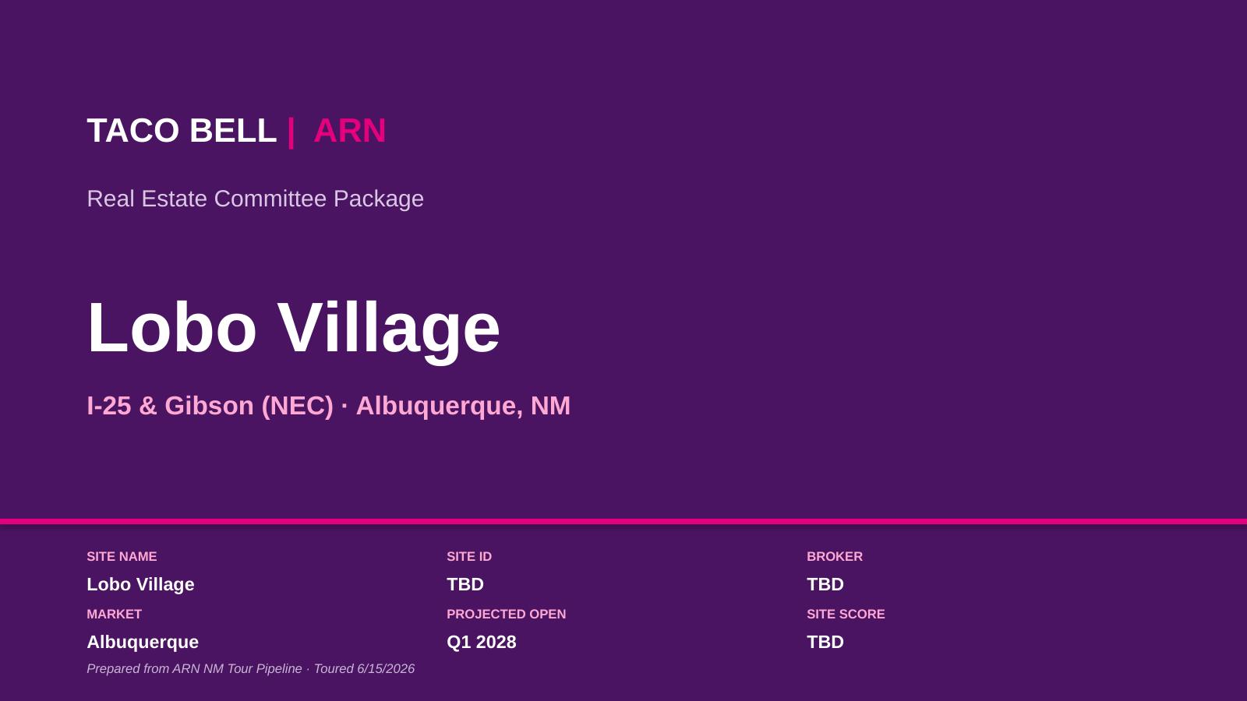
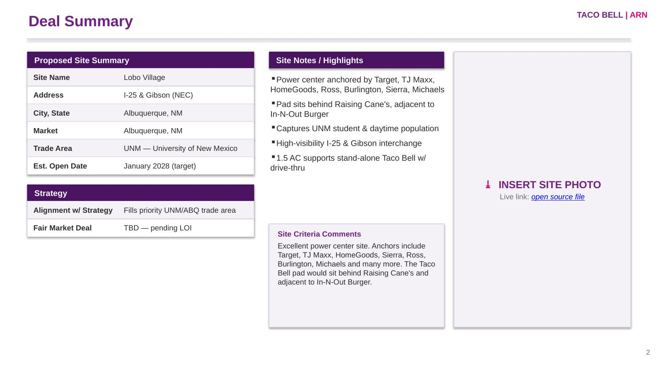
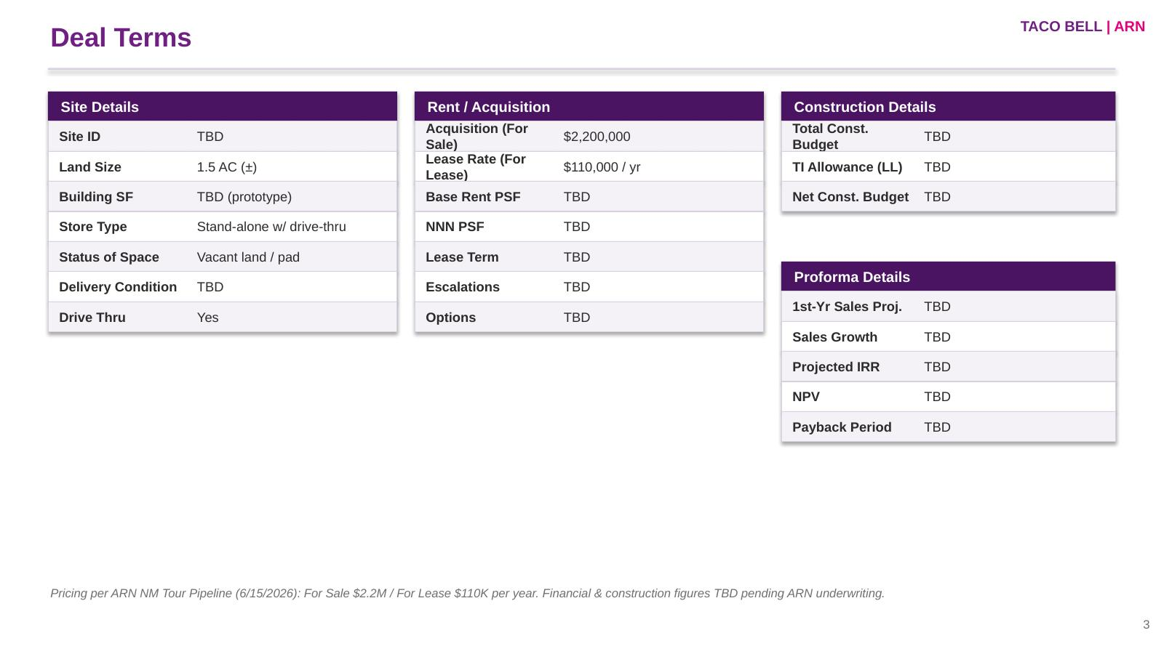
PIPELINE PLAYBOOK
TACO BELL | ARN
Exhibit A — Site Package (NRO Committee)
The standard 17-section Real Estate Committee package for a new restaurant opening — example: Lobo Village (I-25 & Gibson, ABQ).
Cover
Deal Summary
Deal Terms
Includes:
▪ Deal Summary & Site Highlights
▪ Deal Terms (site / rent / construction / proforma)
▪ Site Scorecard
▪ Market Strategy Map
▪ Aerials / Site Plan / Interior
▪ Signage & Photos
▪ Contract Standard Deviations
▪ Market Comps (lease / purchase)
▪ QSR Competition (2-mile radius)
▪ Milestone Timeline & Approvals
All package pages follow — populated with the live Lobo Village deal data & links. Editable file: “ARN Taco Bell – Lobo Village Site Package.pptx”
41

Slide 43
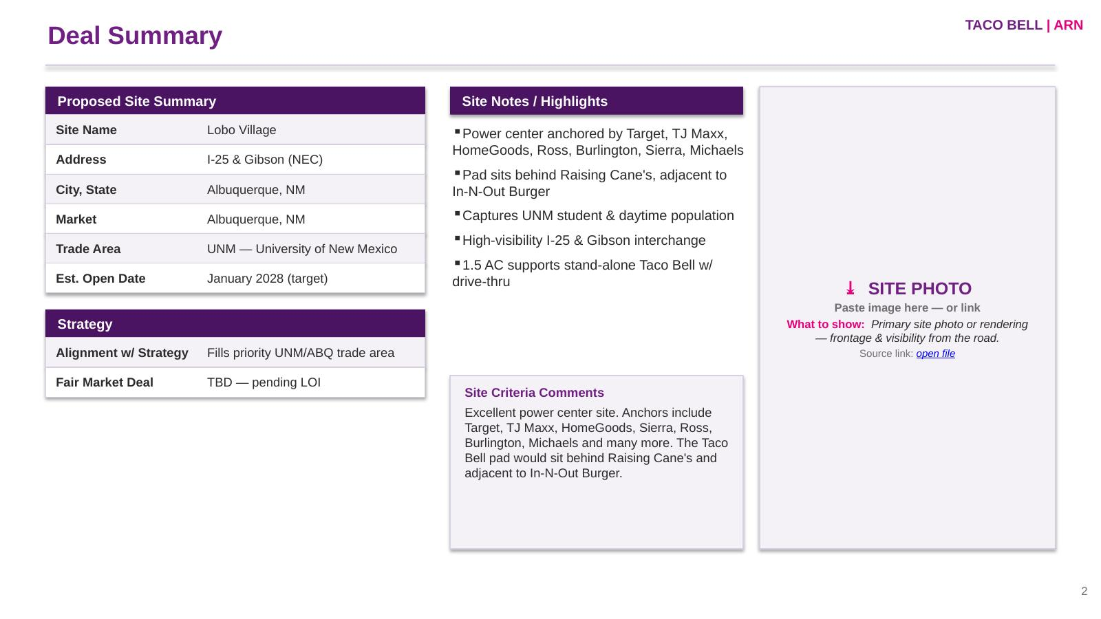

Slide 45
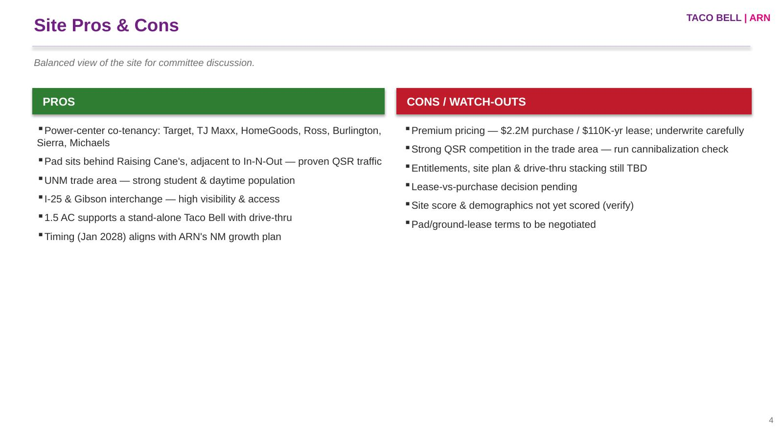

Slide 46
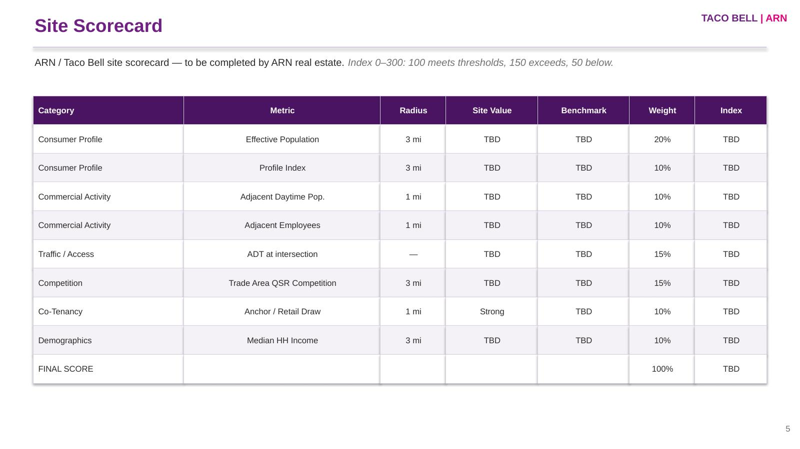

Slide 47
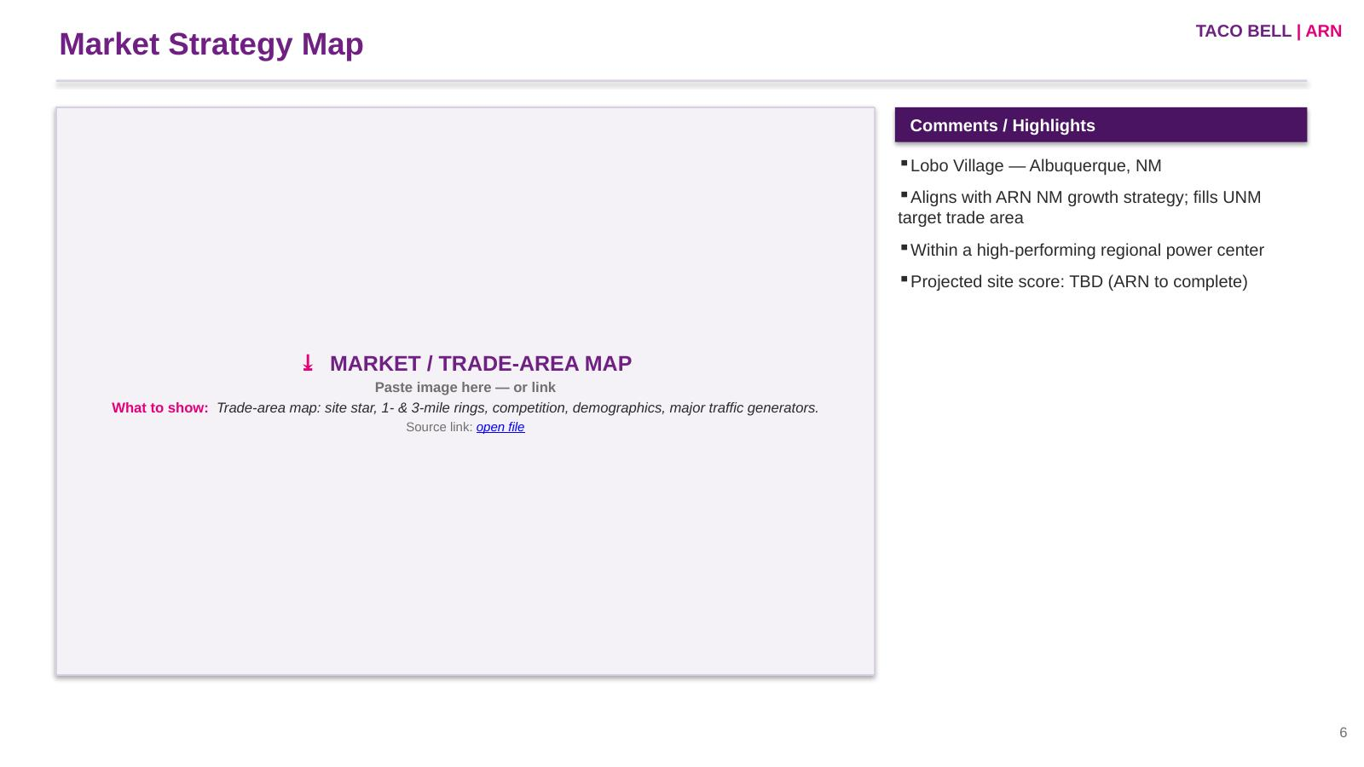

Slide 48
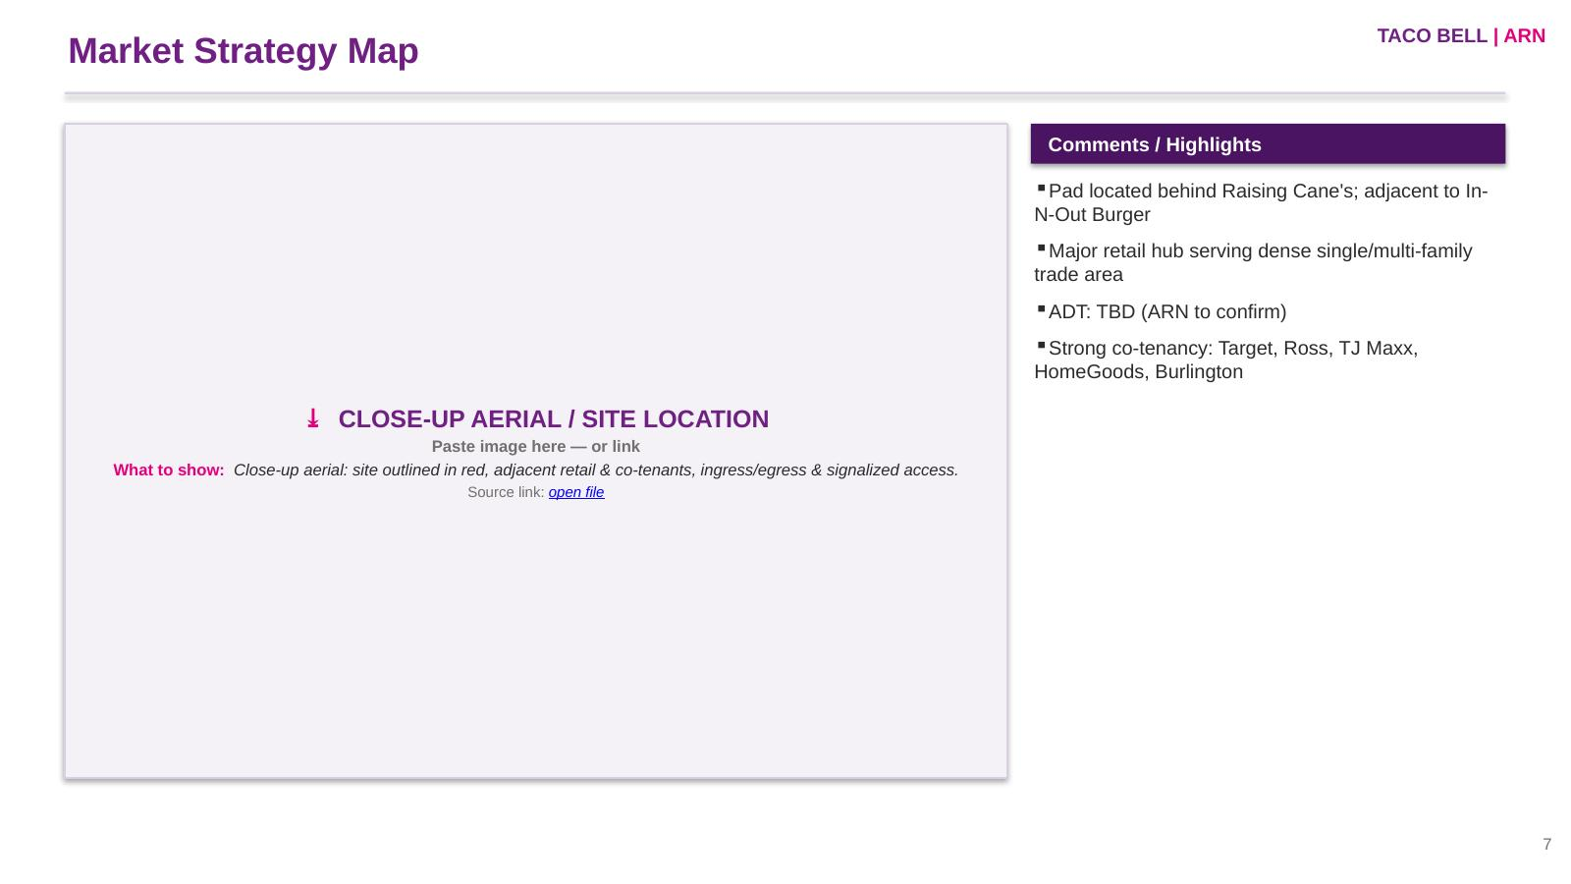

Slide 49
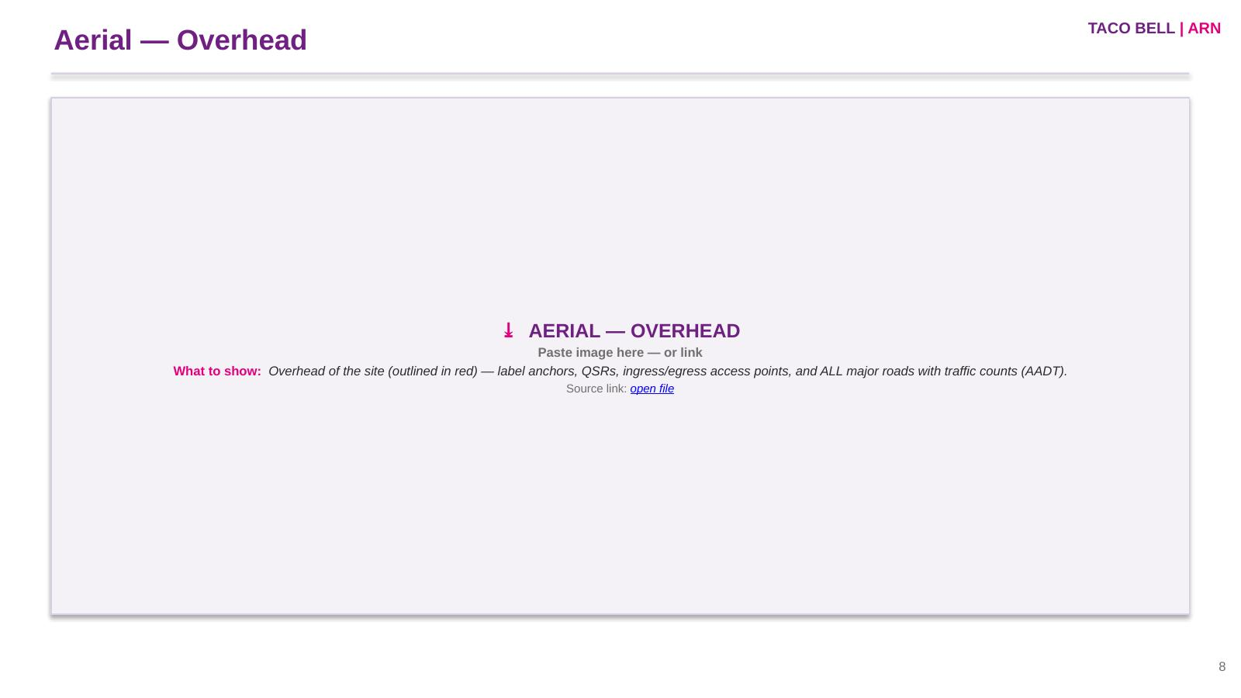

Slide 50
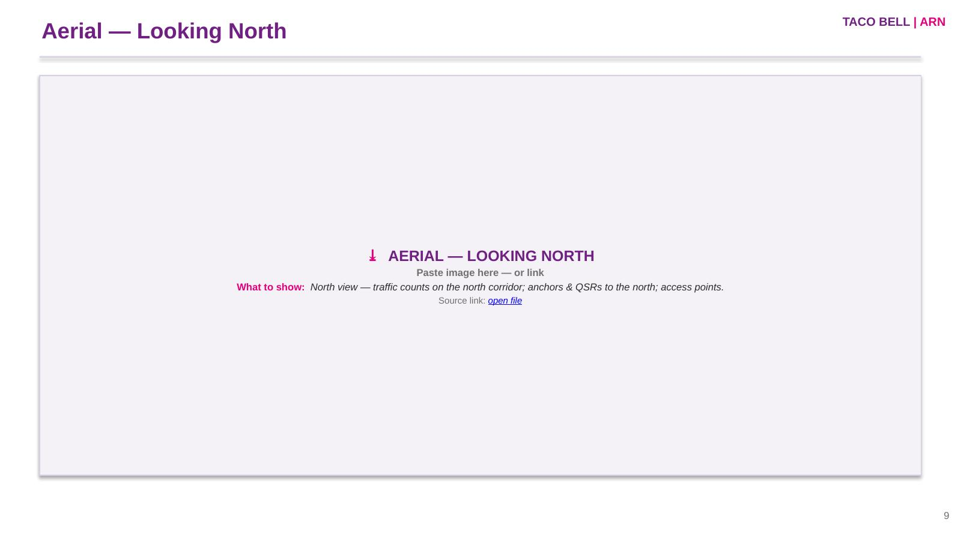

Slide 51
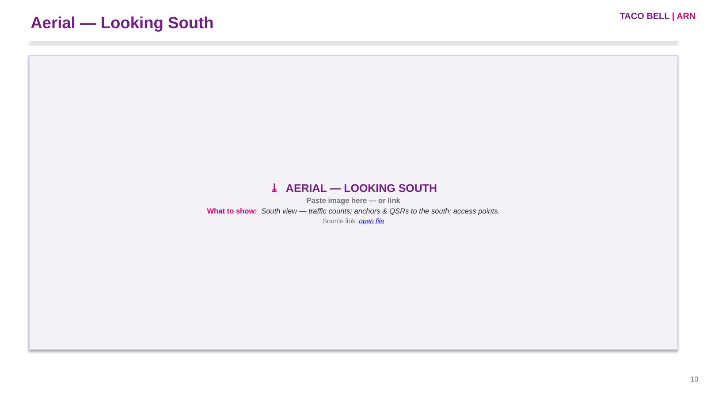

Slide 52
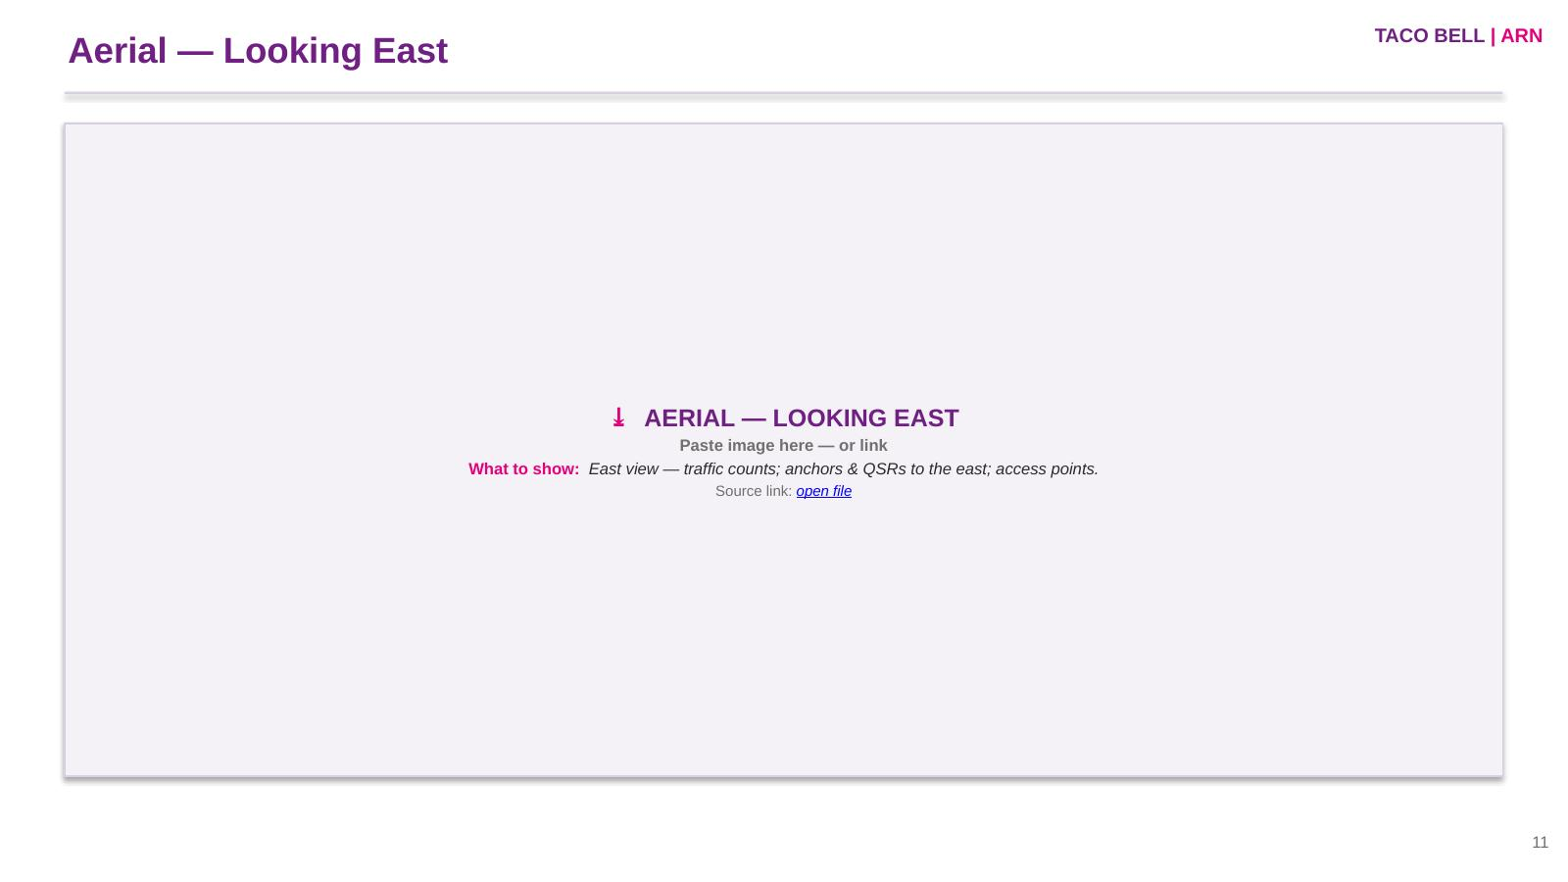

Slide 53
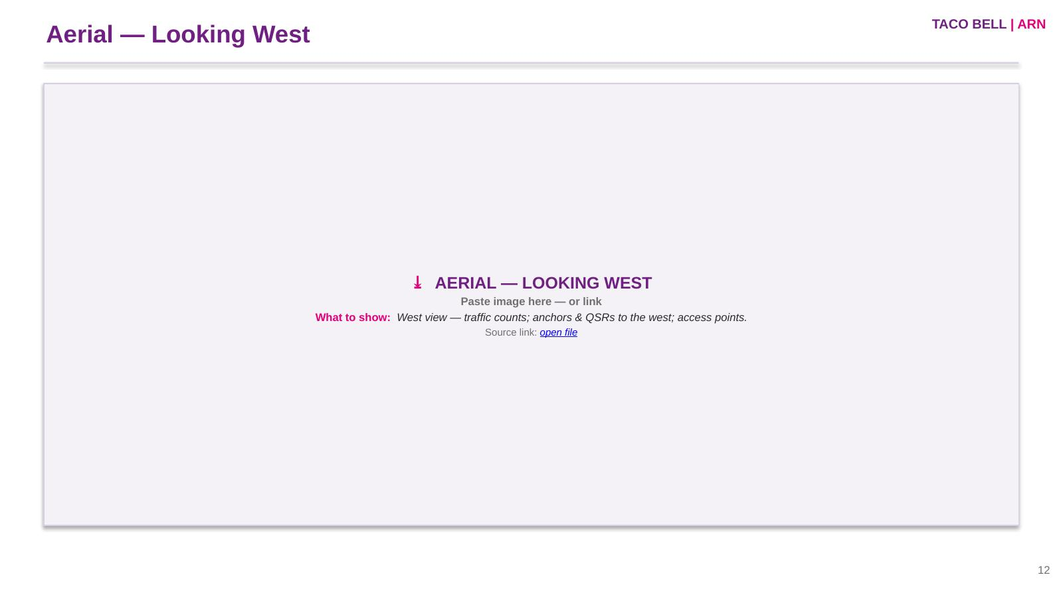

Slide 54
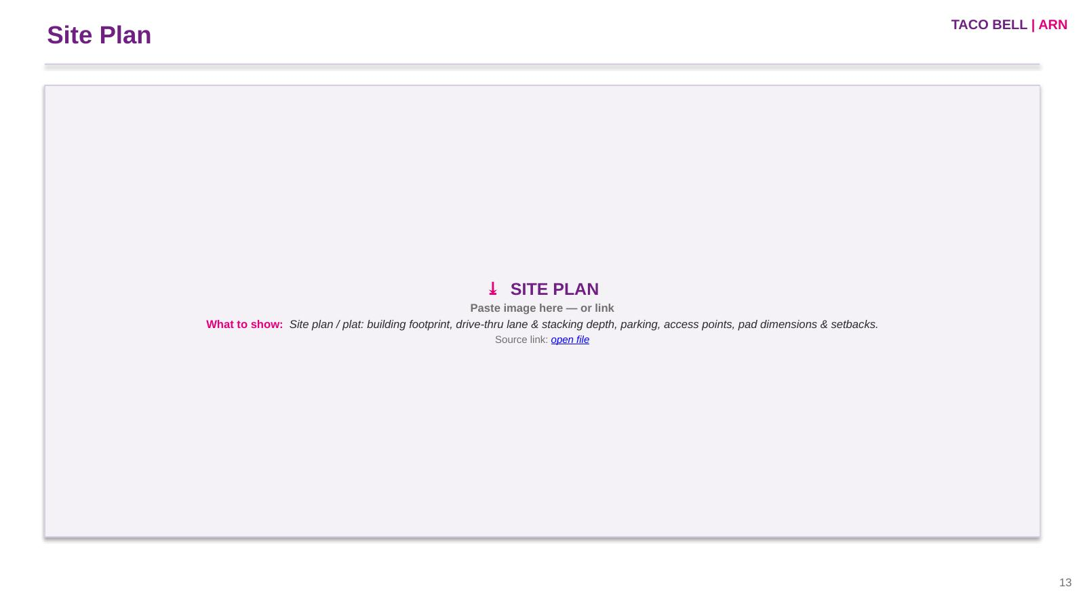

Slide 55
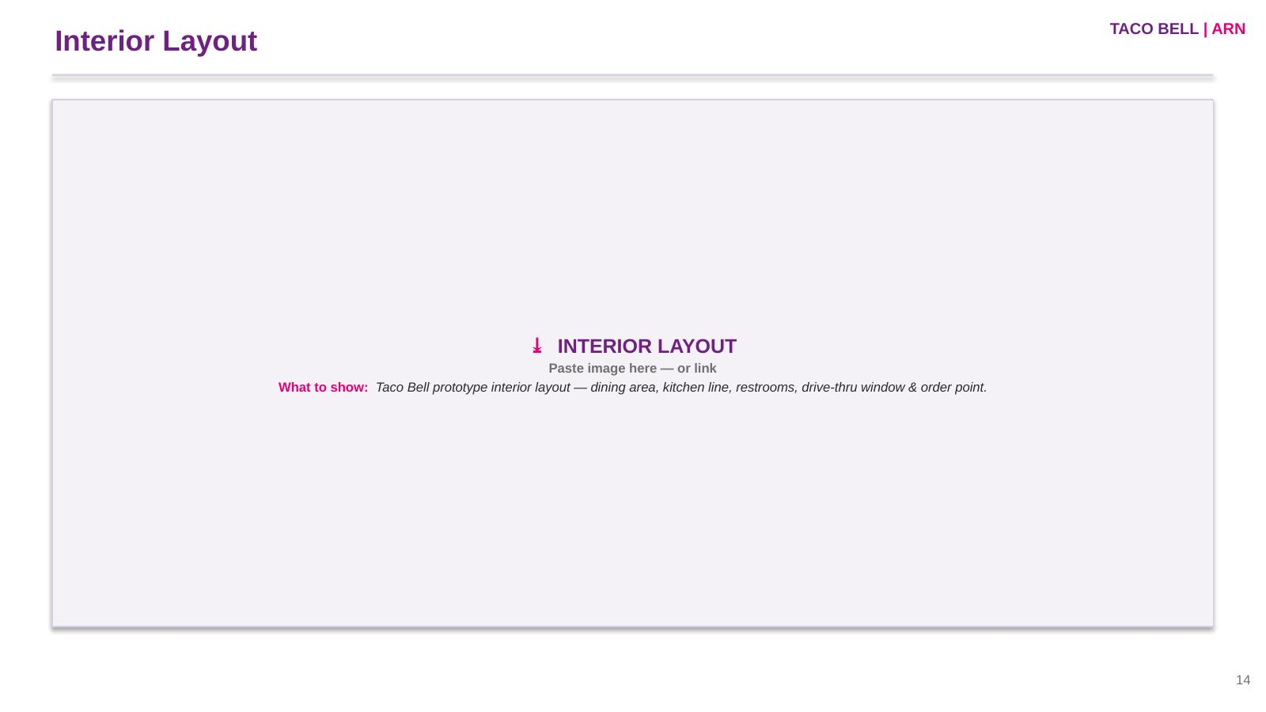

Slide 56
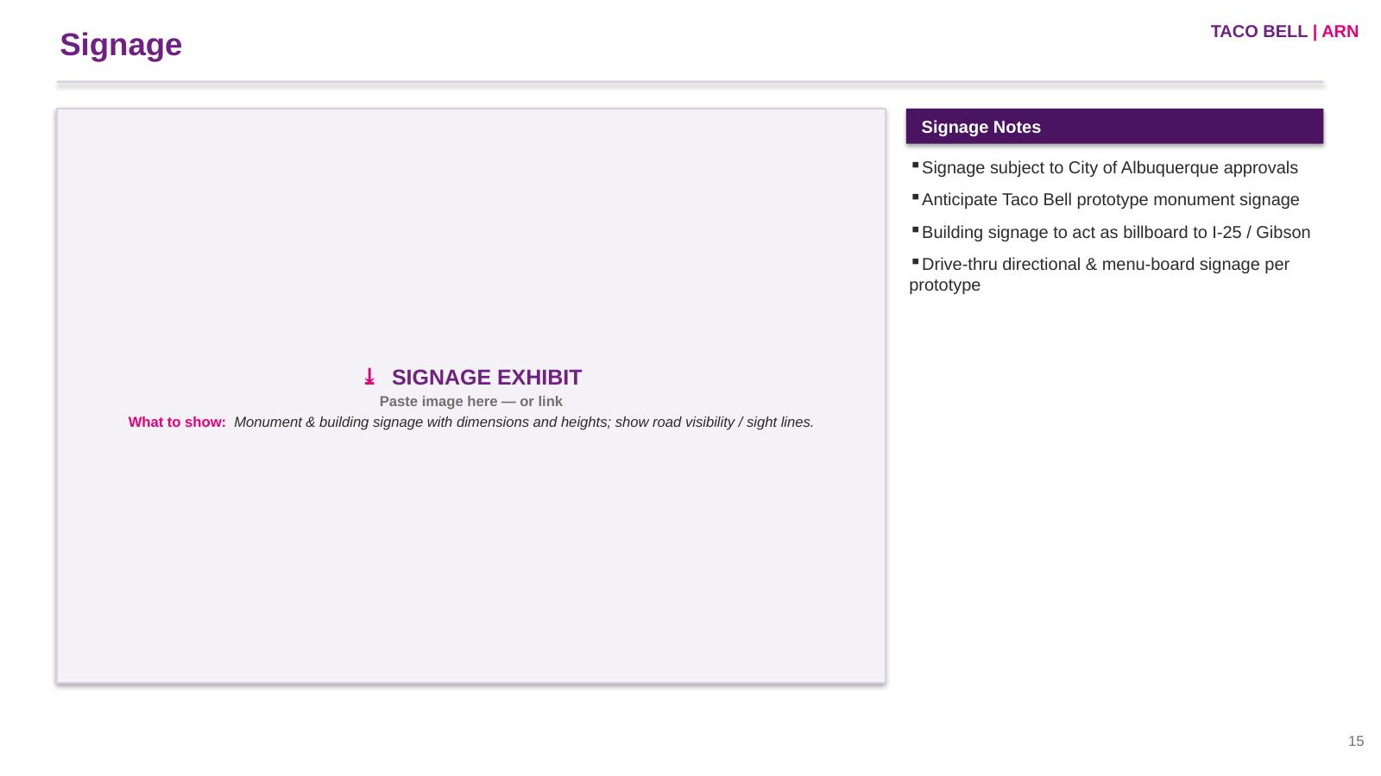

Slide 57
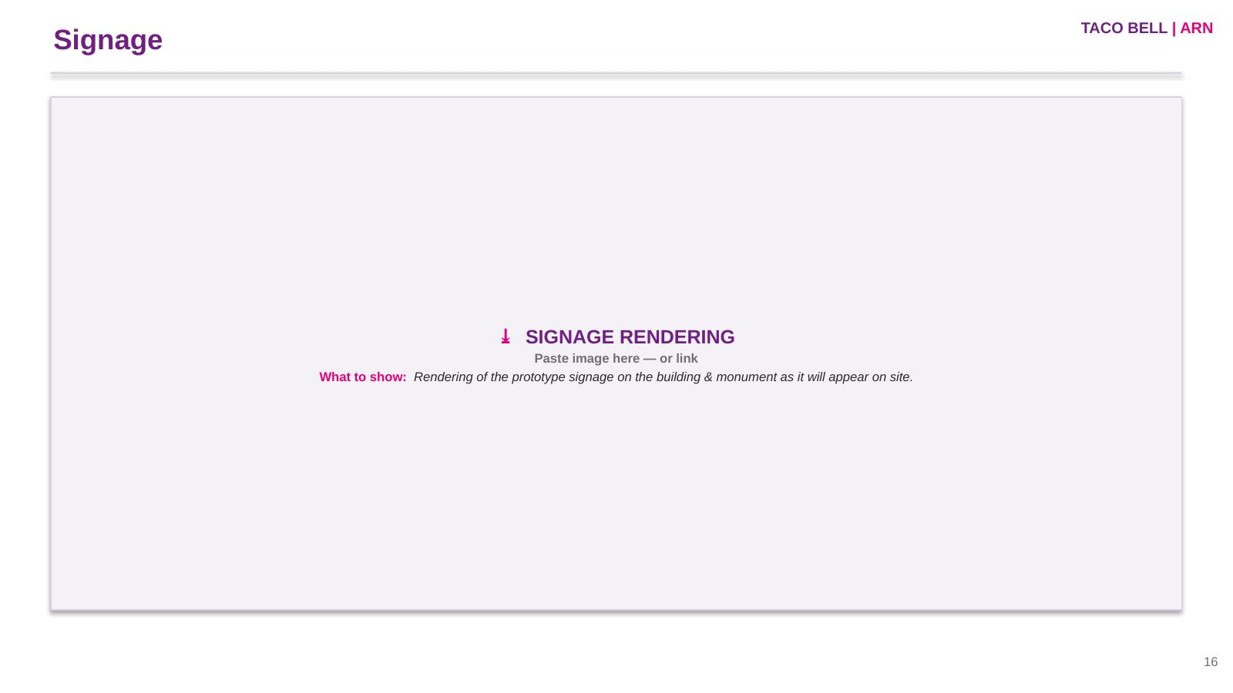

Slide 58
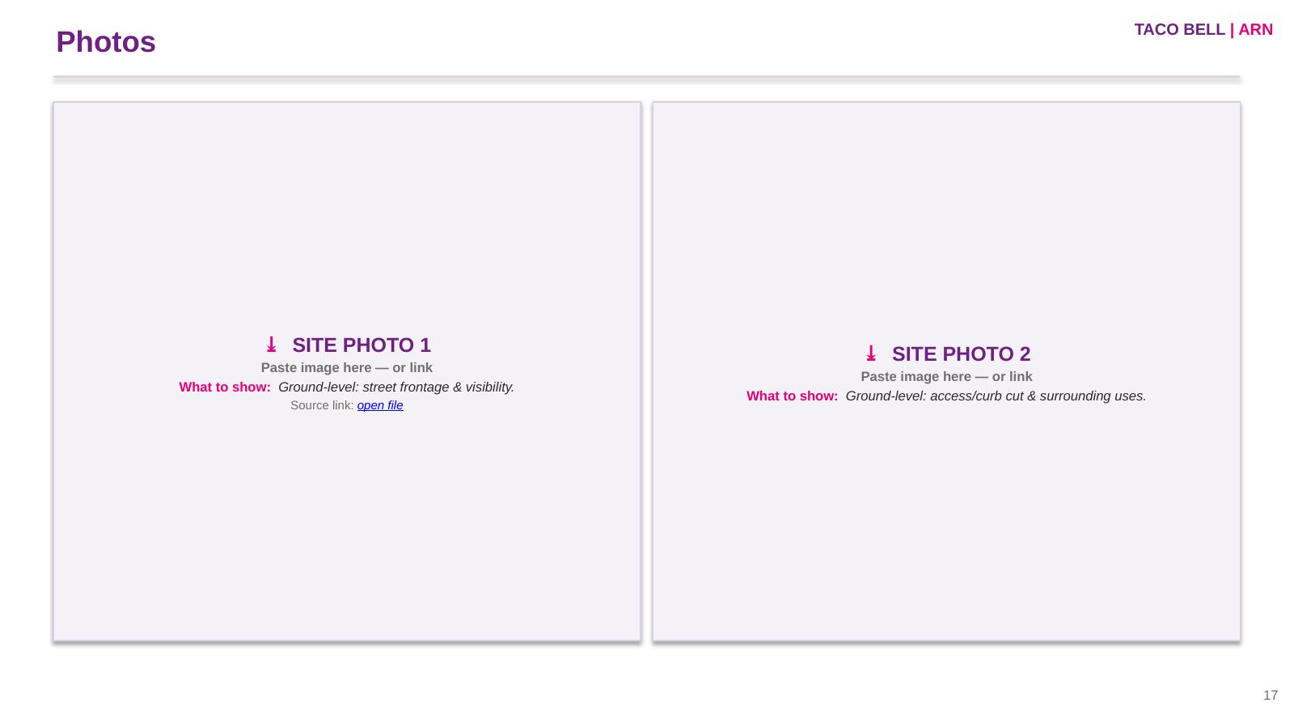

Slide 59
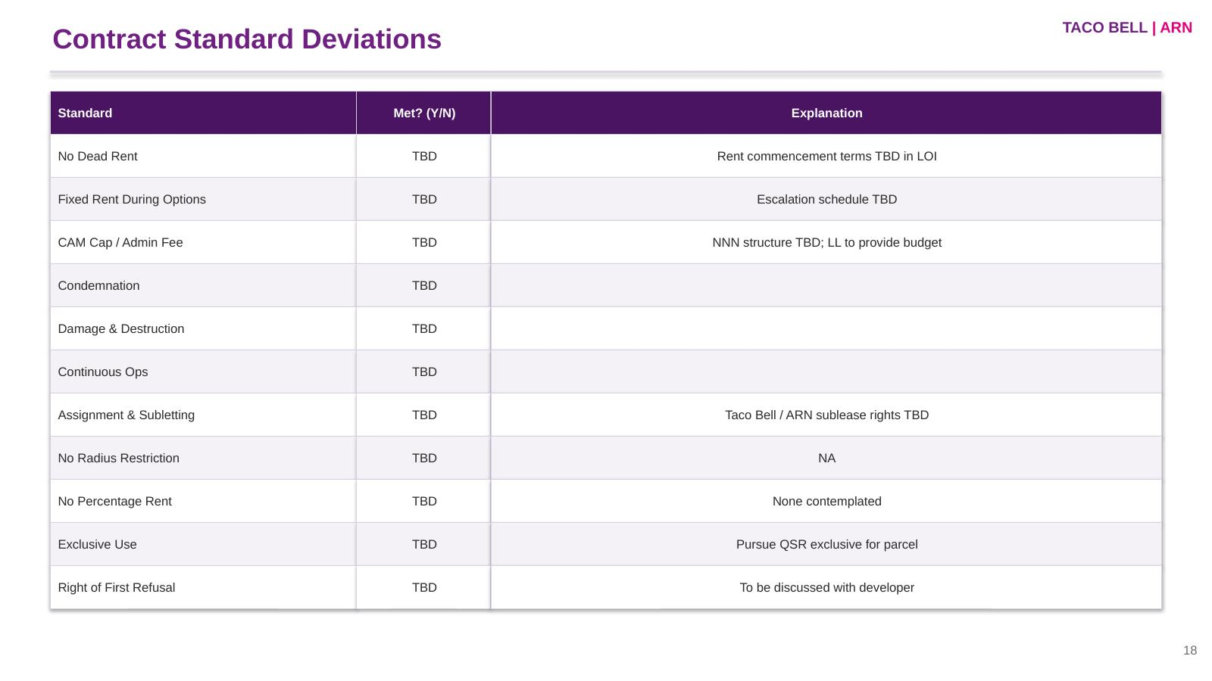

Slide 60
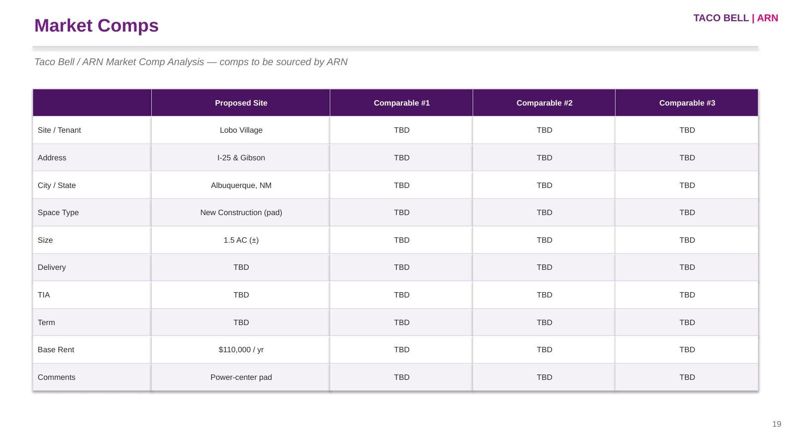

Slide 61
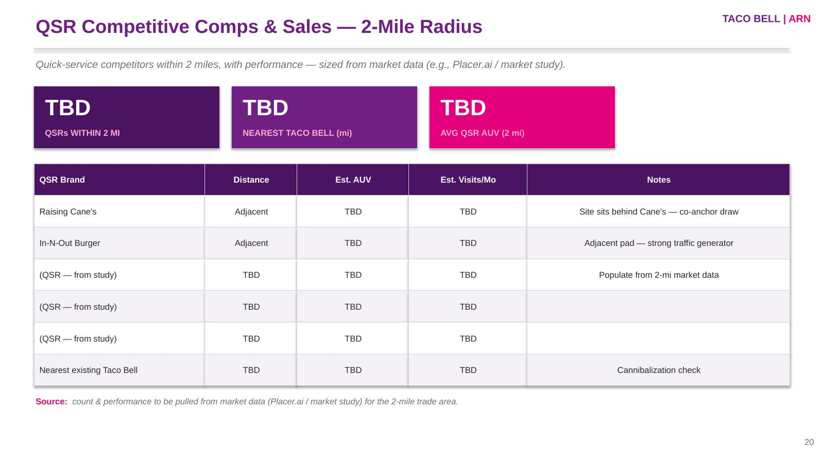

Slide 62
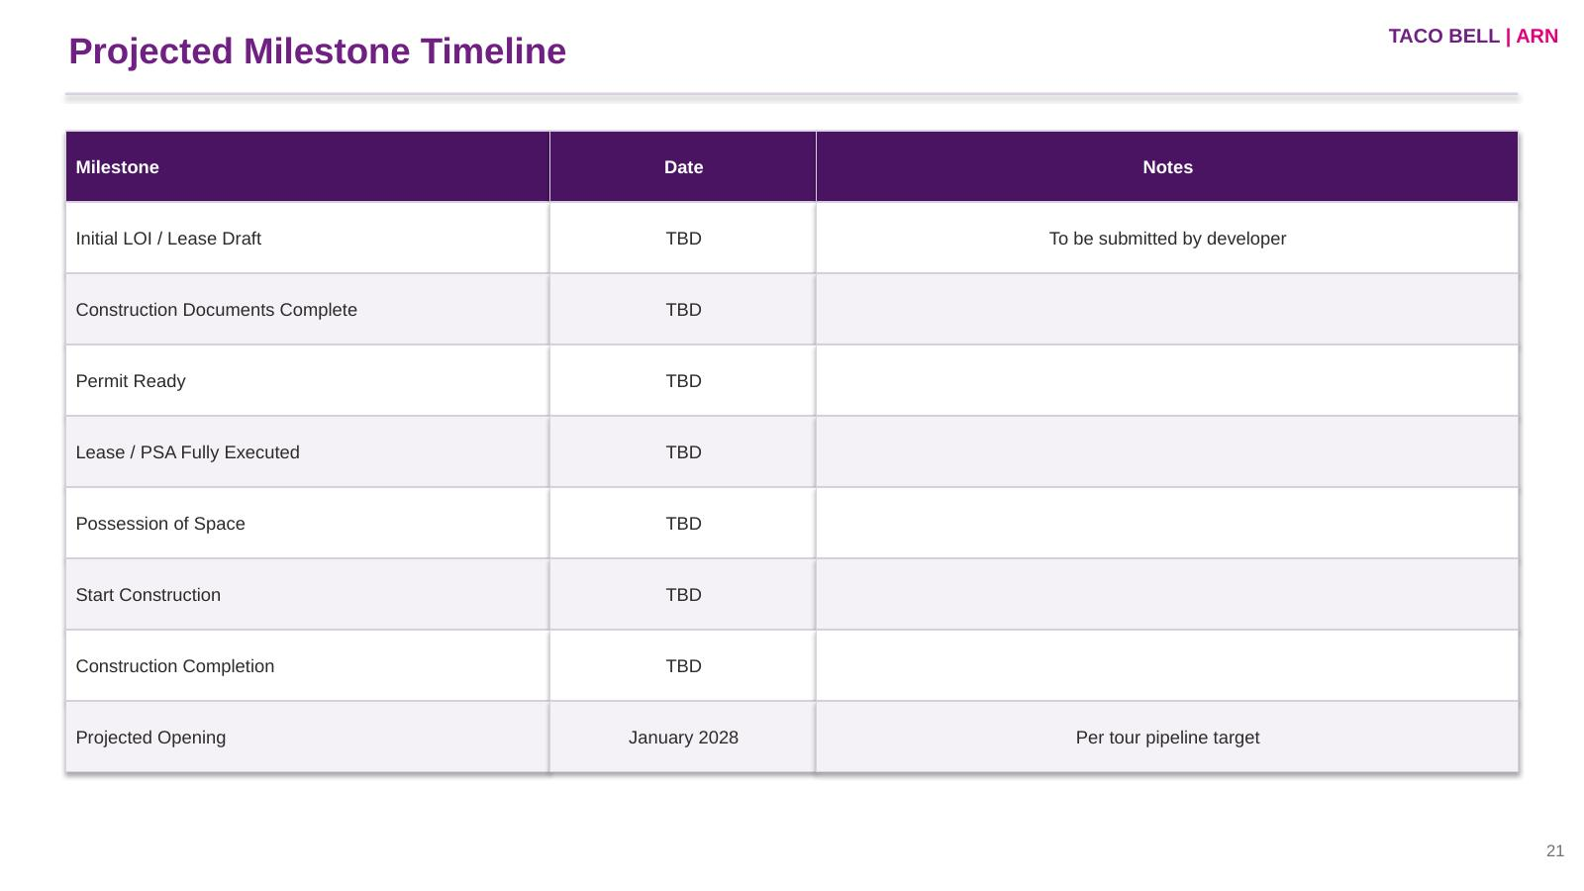

Slide 63
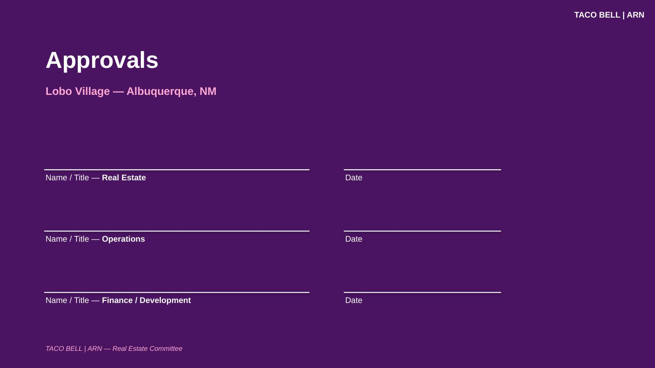

Slide 64
PIPELINE PLAYBOOK
TACO BELL | ARN
Exhibit B — Renewal Evaluation Sheet
Per-restaurant lease evaluation (Operating Restaurant — Key Lease Detail), TB/ARN branded. Companion to the Renewal Tracker.
Restaurant Info
Lease Terms & Rent
Renewal Strategy
Restaurant #
Deal Type
Decision (Renew / Renegotiate / Relocate / Close)
Restaurant Name
Expiration Date
Strategy & Levers
Open Date
Rent Commencement
Sq Ft
Max LXD
Anticipated LL Position
Location Type
Options Remaining
Address
Option Notice Date
Misc & Landlord
City / State
Existing Rent
Committee Approved
Option Rent / Escalations
Lease Critical Date
Performance
2025 Sales
Lease Provisions
Landlord
YoY 24→25
Co-Tenancy
LL Contact / Phone
SOP Margin
Exclusive Use
Approvals
Occupancy %
CAM / Admin
Real Estate
% Rent
Legal
Go Dark / Radius
Exec
64

